Slide 1

Knowledge Discovery Data Mining
Final Project
Abhilash Ugaonkar

Slide 2
Index
Introduction to Dataset: Yelp
Why Yelp
Understanding of Yelp Dataset
Project Scope
Classification of Business Rating
Clustering the frequent words used in reviews
Recommendation of Restaurant Based on Rating and Location

Slide 3
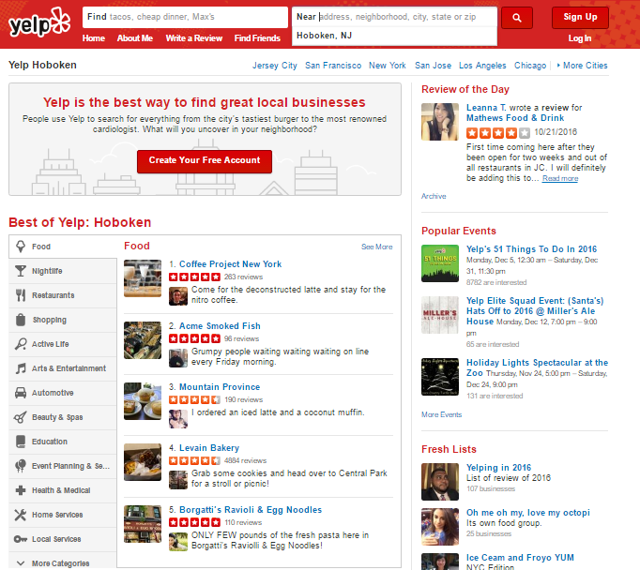
Introduction to Dataset
What is Yelp ?

Slide 4
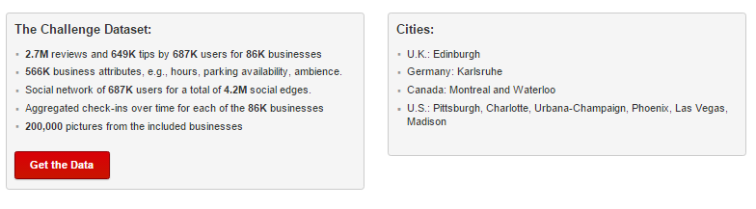
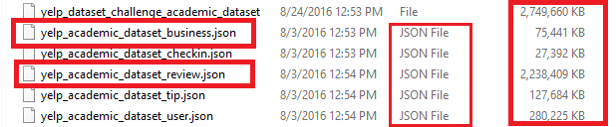
Why Yelp ?

Slide 5
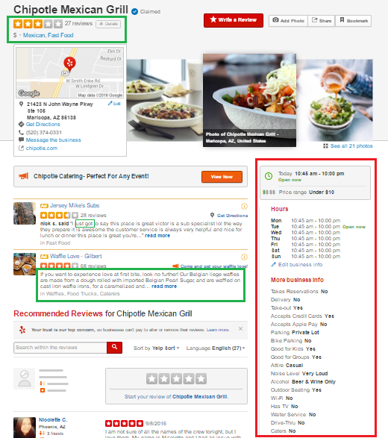
Understanding Yelp Dataset

Slide 6
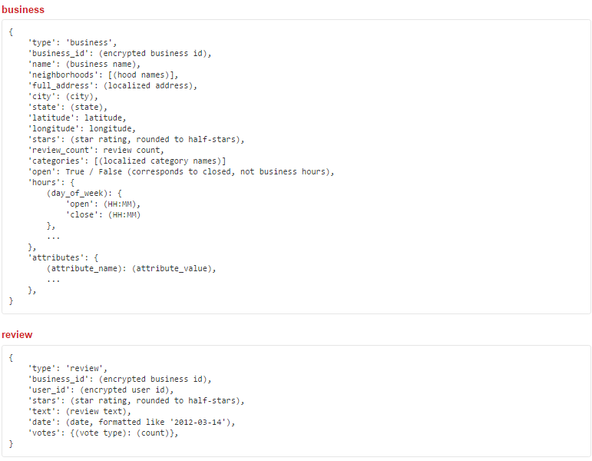
Understanding Yelp Dataset

Slide 7
Scope
Classification of Business Rating
How we implemented: KNN
Clustering the frequent words used in reviews
How we implemented : H-Clustering
Recommendation of Restaurant Based on Rating and Location

Slide 8
Classification of Business Rating

Slide 9
Classification of business rating of restaurants in Arizona
Stars (rating) | Class
<3 | Low
>=3 and <=4 | MEDIUM
>4 | HIGH

Slide 10
Preparing Data for KNN
Data Extraction
Extracting and compiling YELP BUSINESS DATA (JSON --> RDATA)
Total entries in Yelp_business dataset : 61,184 entries
Data Exploration
1. Create data frame and extract each single business and make it a row of data frame “yelpdata”.
3. Select the Restaurant business of state=AZ from Yelpdata

Slide 11
Data Preprocessing : Data cleaning and Data Transformation
1. Identify the services(columns) that has lower NA values(i.e. less than 20% of total data) .
Predictor Variable: (pricerange,alcohol,noiselevel,attire,goodforgroups,
creditcards,outdoorseating,goodforkids,
delivery,takeout,reservations,parkinglot )
Target Variable: stars
2. Remove any duplicate rows
3. Select the restaurants which are OPEN.
4. Data Transformation (Min-Max Normalization)

Slide 12
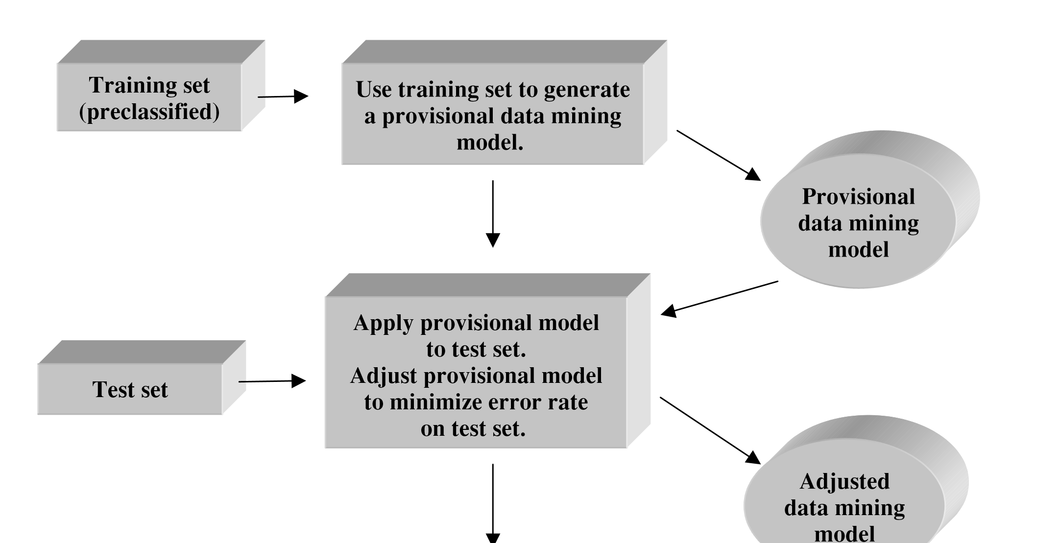
Data Modeling
Classification: Applying KNN
Methodology for supervised modelling:
Total entries post cleaning:
4,837 entries
Training DataSet :
70%
Test DataSet : 30%
K=69

Slide 13
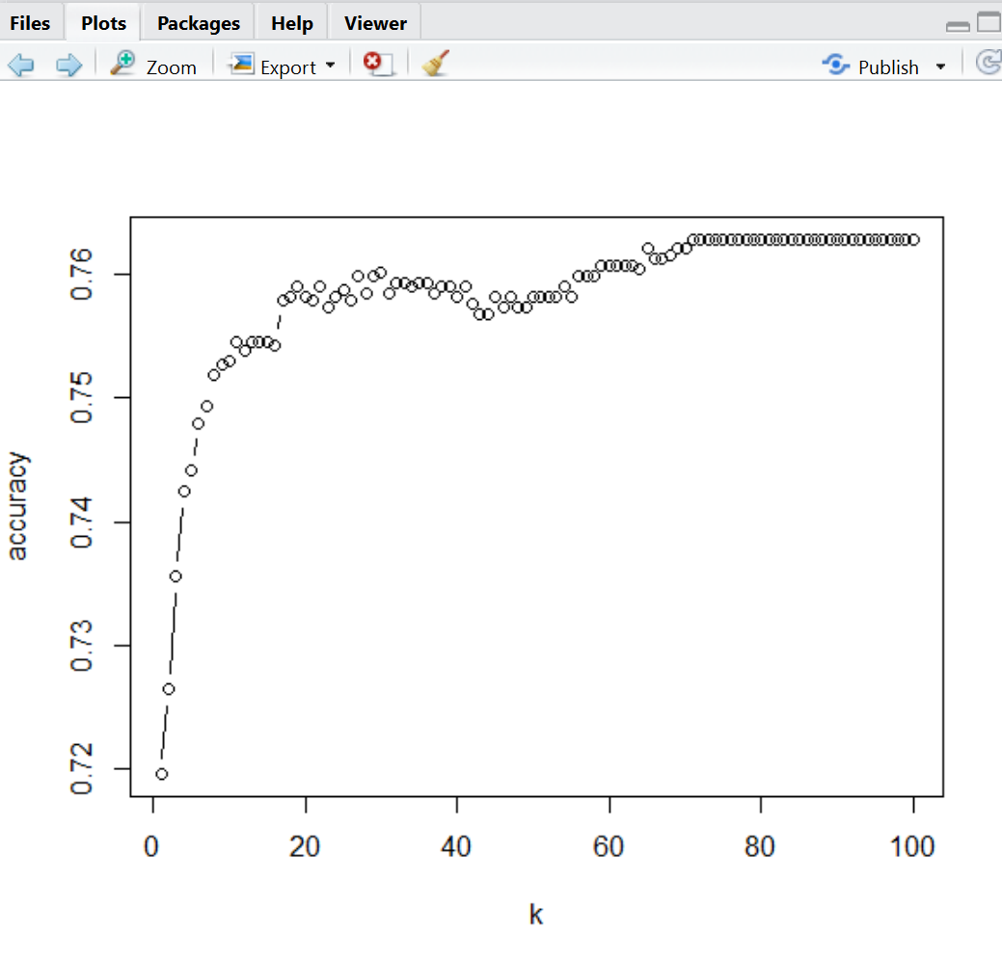
Data Evaluation

Slide 14
Clustering the frequent words in reviews

Slide 15
Why H-Clustering
Yelp uses the reviews for sentiments analysis and Topic Modeling
Topic modeling requires TermDocument Matrix
Hierarchical Clustering is the best representation to organize frequent words as per frequency
For Example:
Good Food , Just One , Great Place etc.

Slide 16
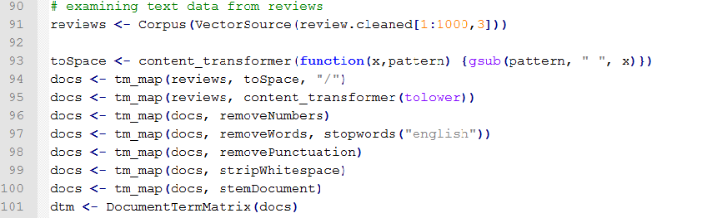
Steps Taken
Translate reviews dataset from JSON to R Data
Read reviews using Corpus Data Structure
Remove the white spaces, blanks, punctuation,
and stop words
Generate TermFrequency Matrix

Slide 17
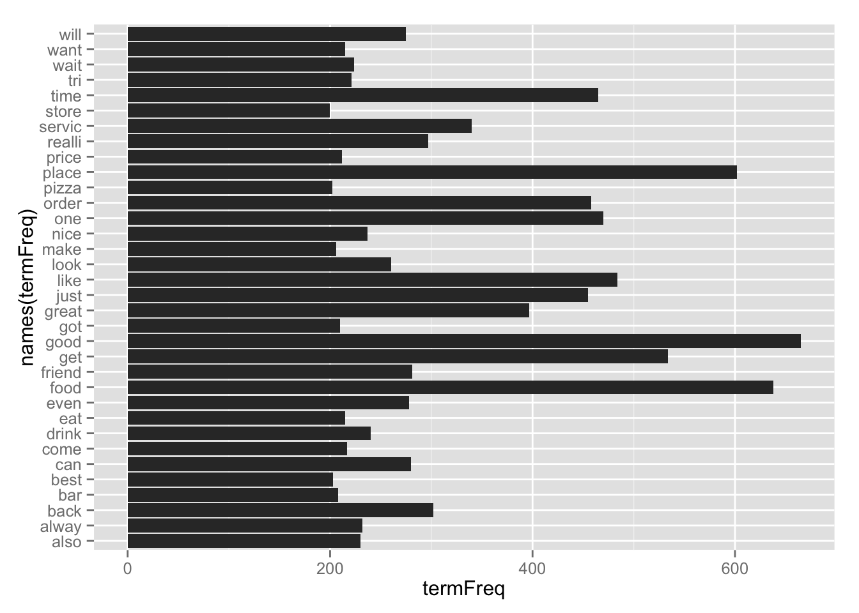

Slide 18
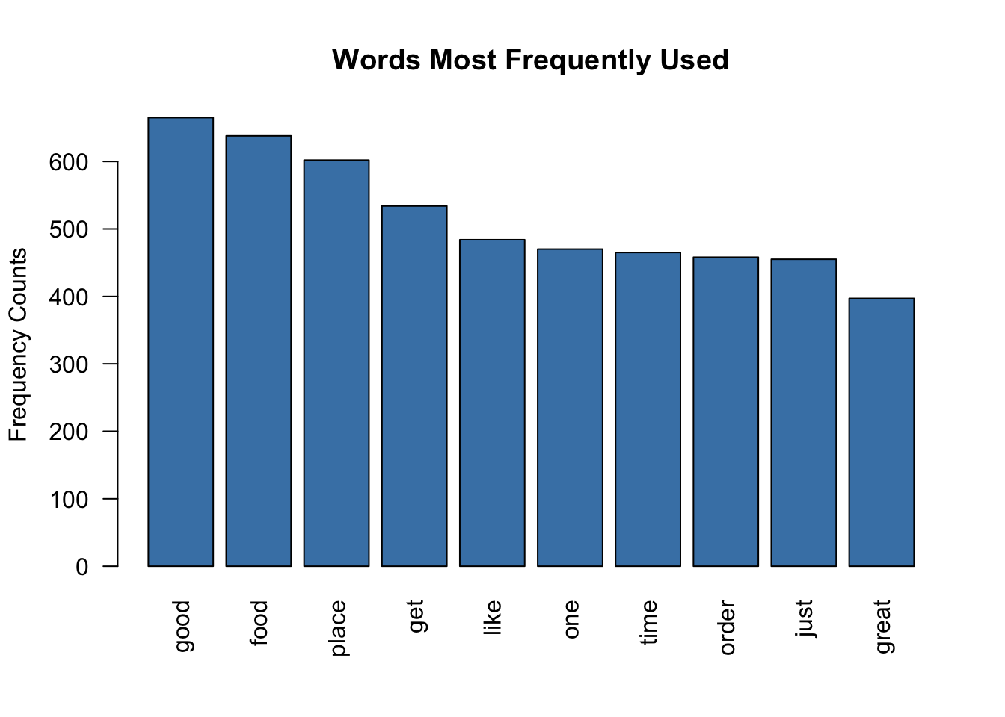

Slide 19
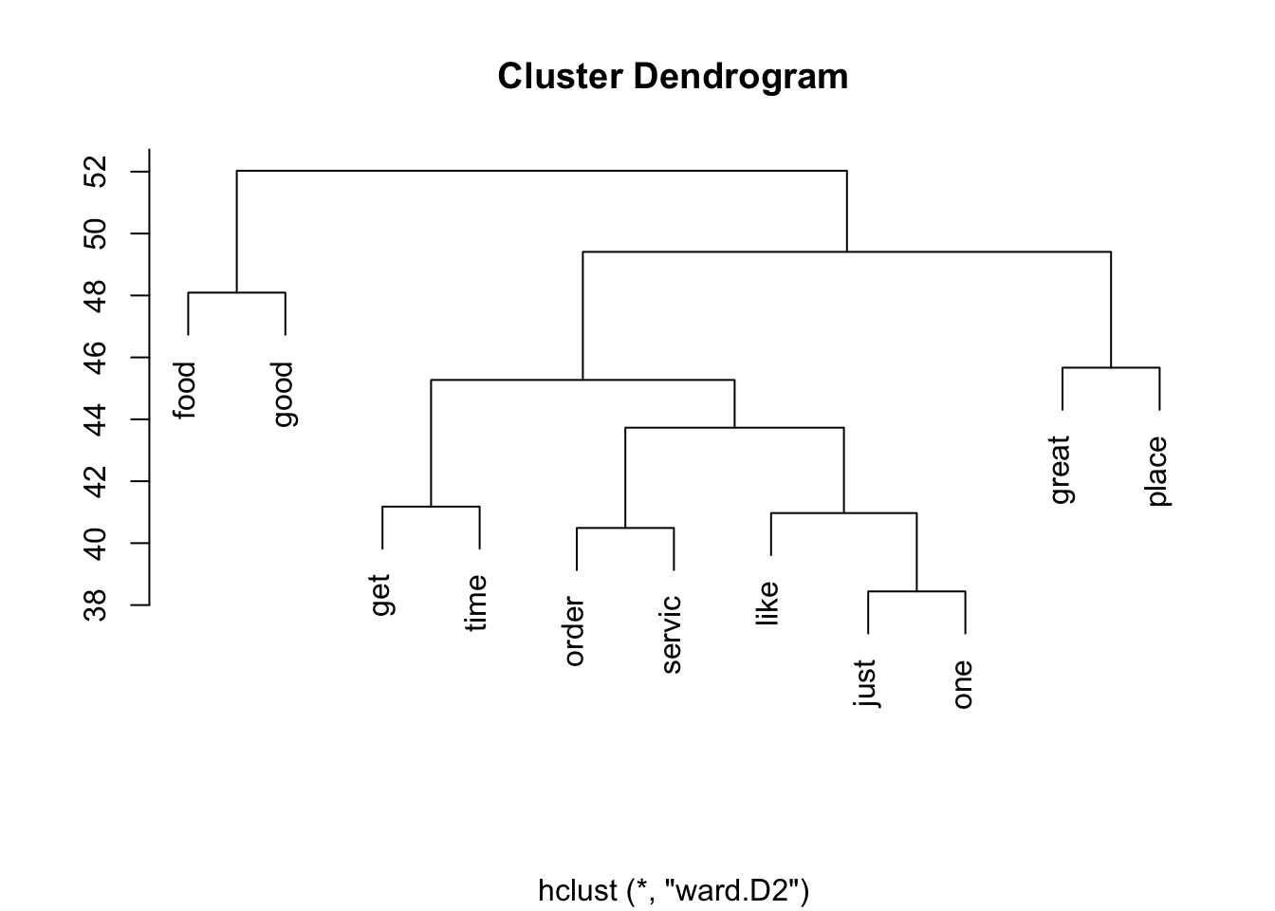
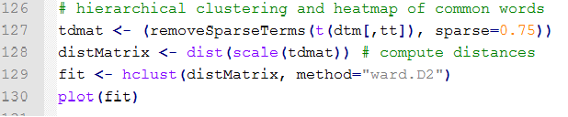

Slide 20
Recommendation of Restaurant Based on Rating and Location

Slide 21
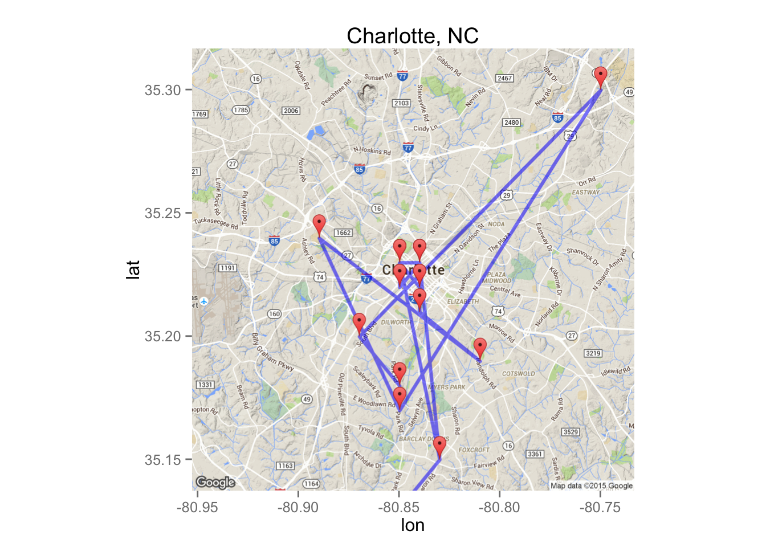
How are we doing it?
Select the State
Select City
Select Business Rating

Slide 22
Conclusion
Given the services or attributes for new business our model classifies it in Low, Medium and High with 76% of accuracy.
We could identify and display the frequent words used in reviews using H-Clustering.
We could recommend the list of businesses given a minimum rating, city and state.

Slide 23
THANK YOU!

Slide 24
Prediction
Actual | High | Low | Medium
High | 2 | 12 | 135
Low | 0 | 105 | 317
Medium | 0 | 65 | 719

